Slide 1
Choleski’s Method
B.3

Slide 2
LU Decomposition
LU Decomposition is another method to solve a set of simultaneous linear equations
Which is better, Gauss Elimination or LU Decomposition?
To answer this, a closer look at LU decomposition is needed.

Slide 3
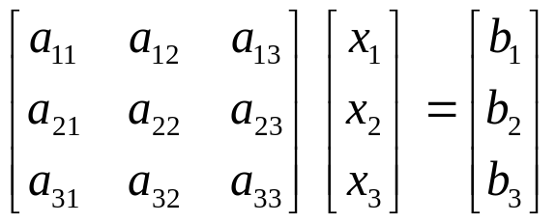
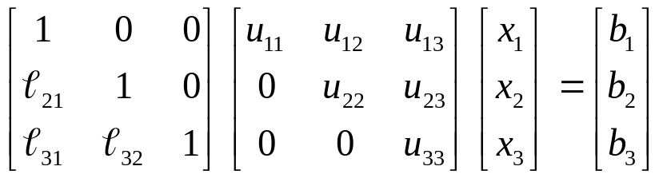

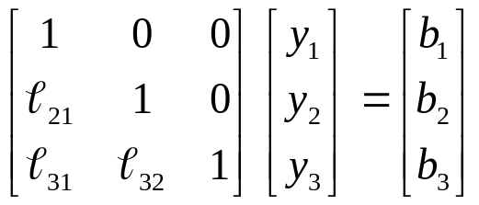


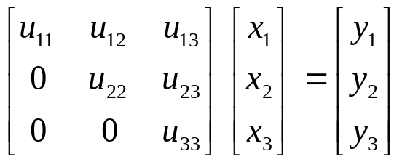
The Method
Decompose
Forward substitution:
  Given [L] and [B] find [Y]
Backward substitution
  Given [U] and [Y] find [X]
?
?

Slide 4




LU Decomposition
How is this better or faster than Gauss Elimination?
Let’s look at computational time.
n = number of equations
To decompose [A], time is proportional to
To solve and
time proportional to

Slide 5
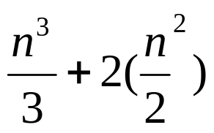
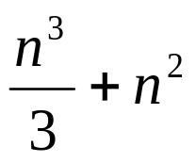
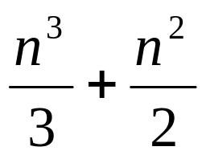
LU Decomposition
Therefore, total computational time for LU Decomposition is proportional to
or
Gauss Elimination computation time is proportional to
How is this better?

Slide 6
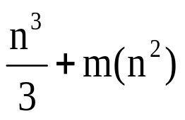
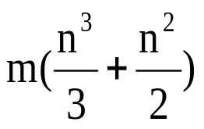


LU Decomposition
What about a situation where the [B] vector changes?
In LU Decomposition, LU decomposition of [A] is independent of the [B] vector, therefore it only needs to be done once.
Let m = the number of times the [B] vector changes
The computational times are proportional to
LU decomposition =
Gauss Elimination =
Consider a 100 equation set with 50 right hand side vectors
LU Decomposition =
Gauss Elimination =

Slide 7
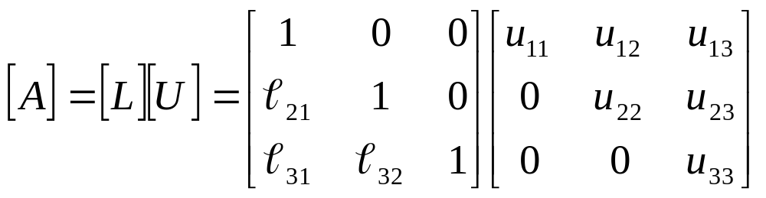
LU Decomposition
Method: [A] Decompose to [L] and [U]
[U] is the same as the coefficient matrix at the end of the forward elimination step.
[L] is obtained using the multipliers that were used in the forward elimination process

Slide 8
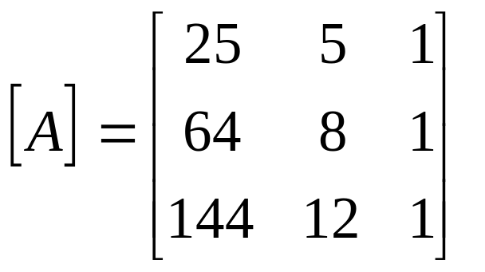
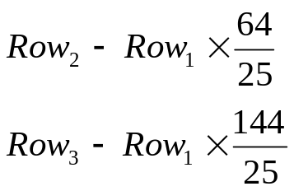
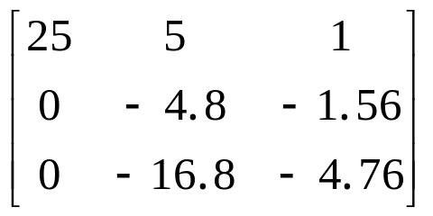
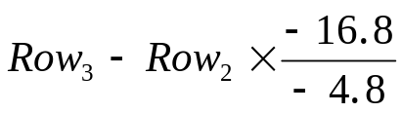
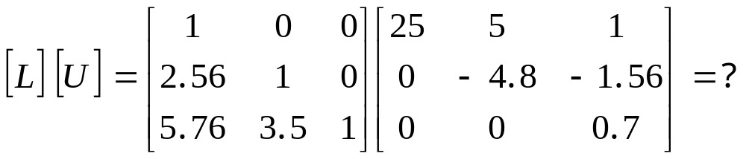
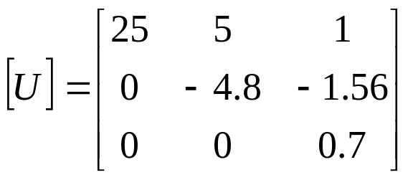
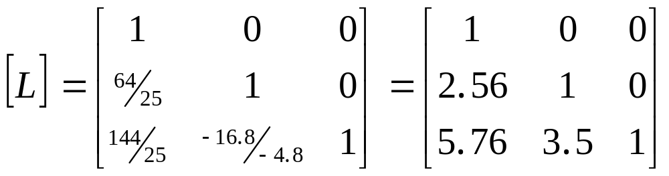
LU Decomposition

Slide 9
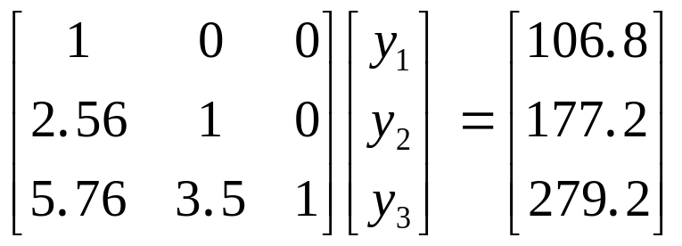
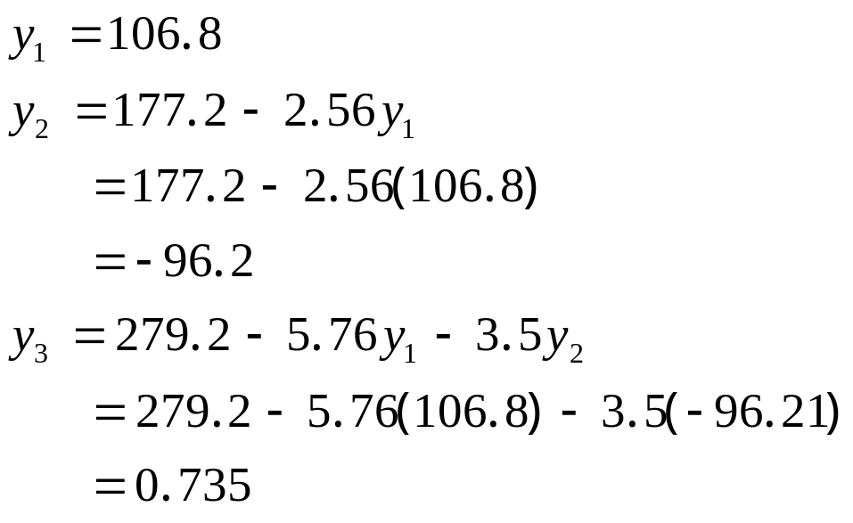
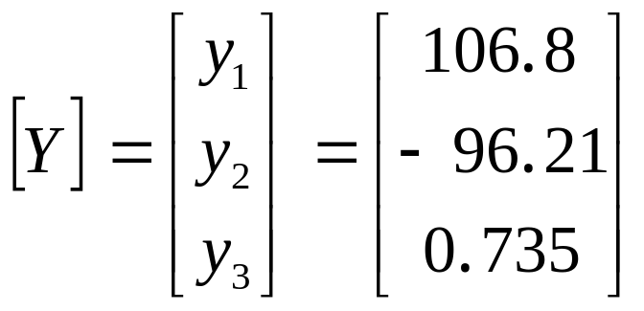
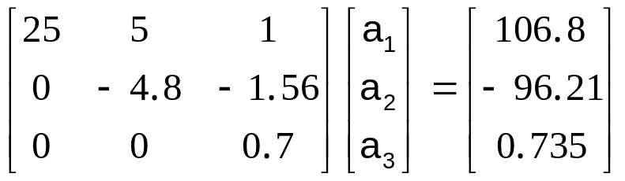
Forward Substitution
Solve [L][Y]=[B] for [Y]
Recall: [Y] is the same right hand side matrix, as obtained by Gauss elimination method

Slide 10
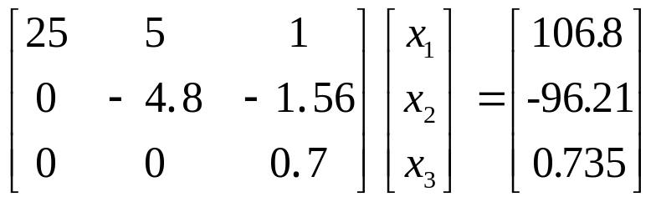
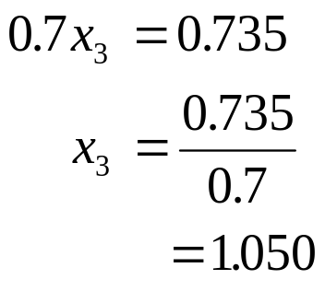
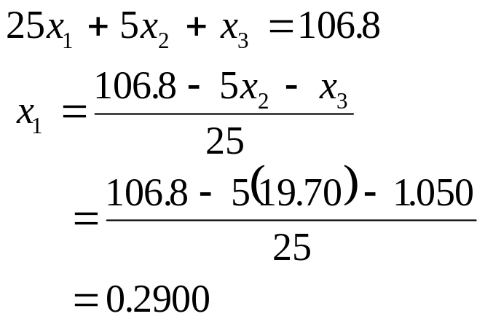
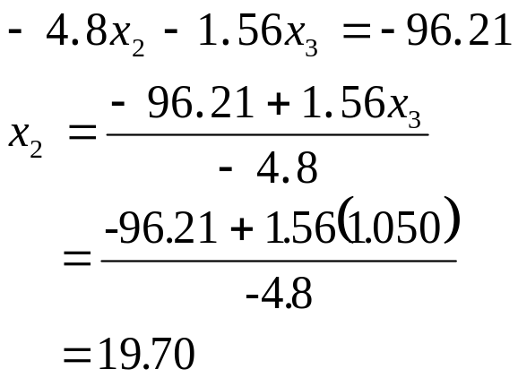
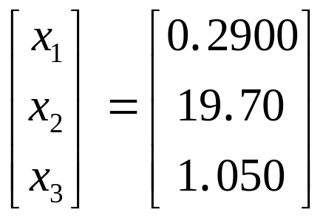
Backward Substitution
Solve [U][X]=[Y] for [X]

Slide 11
Computing Inverse Matrix
B.4

Slide 12
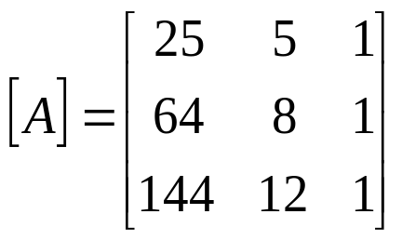
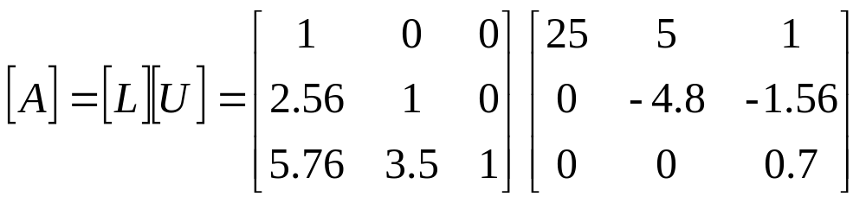
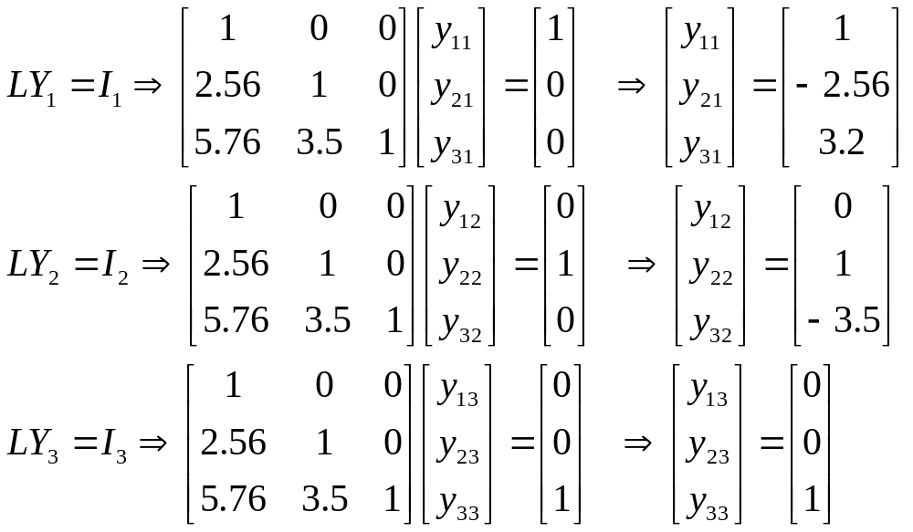
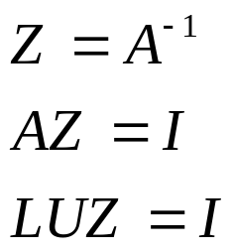


Finding Inverse

Slide 13
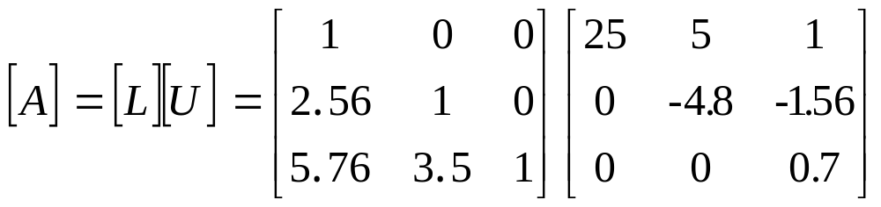
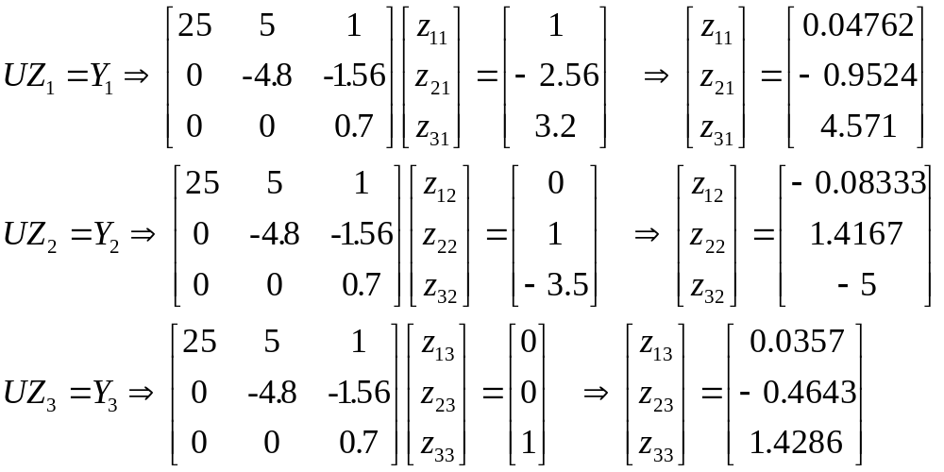
Finding Inverse

Slide 14
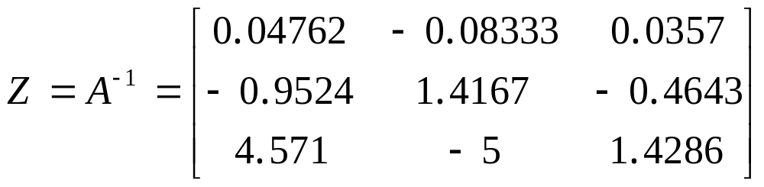
Finding Inverse

Slide 15
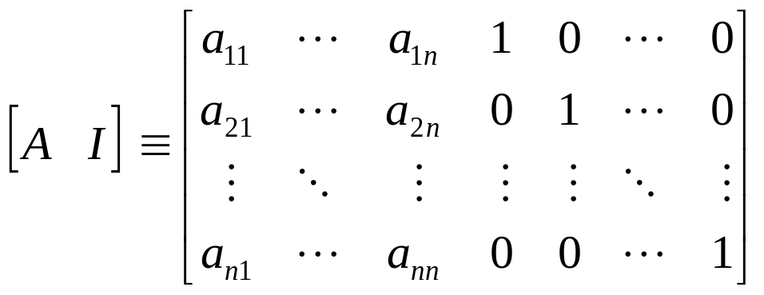
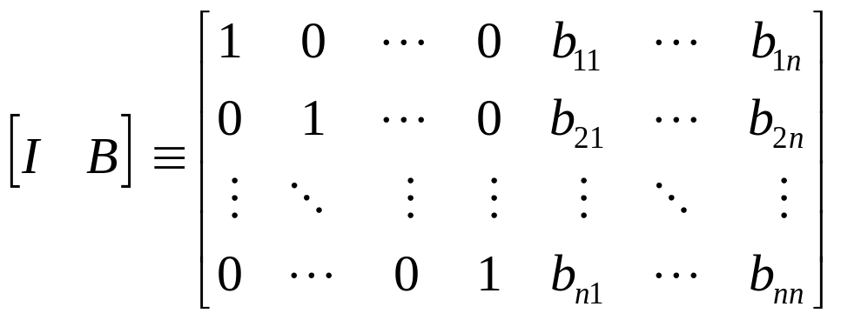
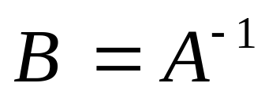
Finding Inverse by Gauss-Jordan
Gauss-Jordan
This method is numerically unstable unless complete pivoting is used

Slide 16
Thanks to Prof. Autar Kaw for his wonderful slides

